Slide 1
Case Study
Supply Chain Management & Data Analysis

Slide 2



Analytics Case – 1º Dataset
Rows: 5M,223k
Columns: 9
-Tour_id
-Tour_status
-Datetime_published
-Origin_country
-Destination_country
-Shipper_id
-Invited_carrier_id
-Offer_placed
-Carrier_assigned
Ids: 30.783
Shippers: 118
Carriers: 16.410
Countries: 4 – 16 Combo chances
Time: 2023- March, April, May
Tour_status: True/False
Offer_placed: True/False
Carrier_assigned: True/False
1

Slide 3
Analytics Case Monthly Offers & Status
<2% Overall Invitations Offers = Positive *Repeated ID
Offers
Status
3,48%
3,42%
86 IDs expired having an offer
4,31%
2,13%
All 90% False
All 96% Completed
Completed: 29.365 / Expired: 1.148
2
True: 101.709 / False: 5.121.345

Slide 4
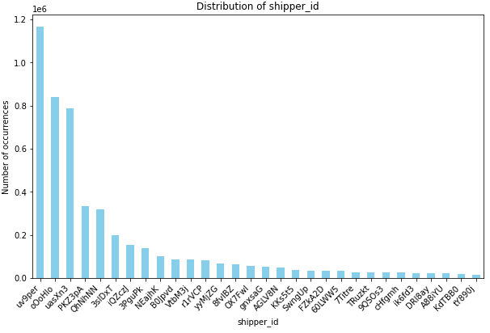
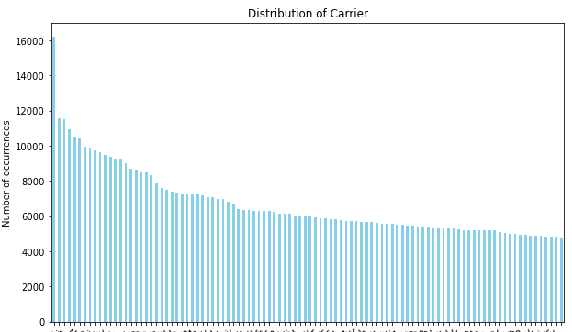
Analytics Case Top Carriers & Shippers
Month | By Tour | Invitation
3 | 42,8 AVG | 124,6 AVG
4 | 44,1 | 128,7
5 | 38,8 | 132
Std Single Tour: 123 -145
Distribution of Invitations by Shipper
Month | By Tour | Invitations
3 | 104,5 AVG | 16.765 AVG
4 | 106,5 | 18.612
5 | 93,2 | 16.211
Std Tour: 227 - 259
Distribution of Invitations by Carrier
Top 10 Carriers = Won 15% Overall Orders and 2% - Overall Invitations
Top 10 Shippers = 65% Overall Orders
and 78% Overall Invitations
*Global Mean/Invitation 44K
*Global Mean/Invitation 318,28
3

Slide 5

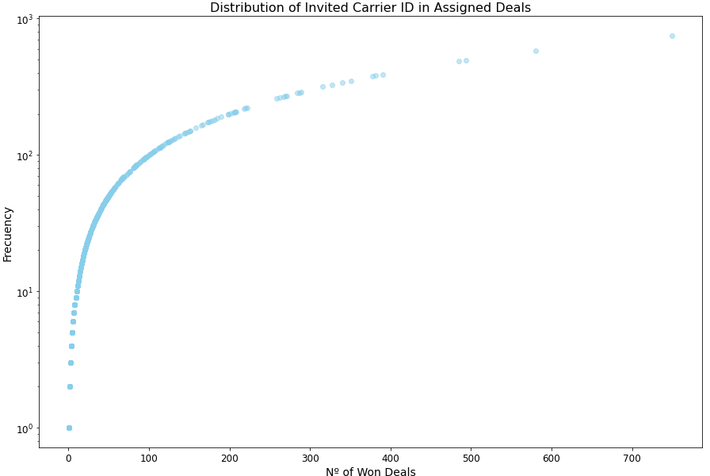
Who gets Deals?
Top5Carriers Highst Nº of Deals
0,44% of Overall Assigned Carriers
=
9,10% Overall Won Deals
Total Assigned: 29.635
Total Carriers: 16.410
Sent an Offer: 1.465 Carriers
Who Won?: 1.124
Carriers 1:
Top5Carriers Lowest Nº of Deals
35% Assigned Carriers
=
3,9% Overall Won Deals
Top5 Lowest Nº Wins
Nº of Wins (deals) | Nº of Carriers that won
1 | 227
2 | 121
3 | 64
4 | 68
5 | 45
72,86% Assigned Carriers = 14,54% Overall Won Deals
4

Slide 6

Carriers – Tops & Key Infos
Top15 Carriers with more Invitations, only 3 appears in Top 15 Assigned/TrueOffers sent.
Top15 Assigned, 8 IDs are in TopTrueOffers.
Positive Correlation Tendency
More True Offers = Higher Chance to get a Deal
-------------------------------------
0.53 *Overall
0.84 * Based on Frequency Nª True/Win
Top15 | True Offer AVG | Assignation %
Requested* | 5,21% It seems overperformance, what type of deal/company is it? | 28%
Assigned* | 29% | 39,6%
Nº Requests | 156.840* | 85.305*
5

Slide 7

Shippers – Tops & Key Infos
In essence, the Top16 shippers precisely align with all TOPs16, falling within the range from 10 to 16 matches. Based on Invitations, no Deliveries
Top15 shippers with more Tours match 8/15 of TopCompleted and 14/15 TopRejected. Based on single Delivery
TopRejections have 4 outsiders (new) – What Profile,sector, countries?. Based on Invitations, no Deliveries
6

Slide 8
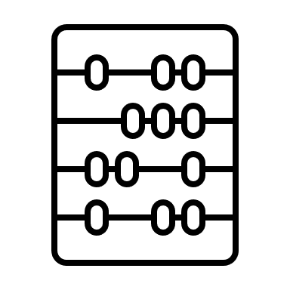
Correlations
Month | Carrier_ID | Shipper_ID | Nº Invitations | Nº Tours
3 | 12.317 | 99 | 1.659.714 | 10.348
4 | 2.347 | 10 | 1.862.218 | 10.640
5 | 746 | 9 | 1.702.122 | 9.795
Do having more active users in a month means more transactions? Quick Answer Yes
There seems to be a trend in Shippers/Carriers and Nº of Invitations per shipment.
Less Shippers = Less Carriers & Less Tours = More Invitations to reach Offers = More Offers = Higher Positive Feedback = Complete
– Supported by Covarianze and Crr
Avg TopRequest (invitations): 5,21% Make an offer
Avg TopTrue (invitations): 26,67% – Only 3 Ids are from Top Request
7

Slide 9





Top Combo Countries
2.248.361
Invitations
Cor Country/Performance
Offer – Dupli Vs Single ID – last one
Status – Dupli Vs Single ID – last one
Countries (individual/combo) with more rejections
3 and 4 - 5.7% and 3, 6%
Vs Individual&Global AVG 2%
8

Slide 10
Thank You

